Slide 1


Computer Hardware
By Carter Moody

Slide 2

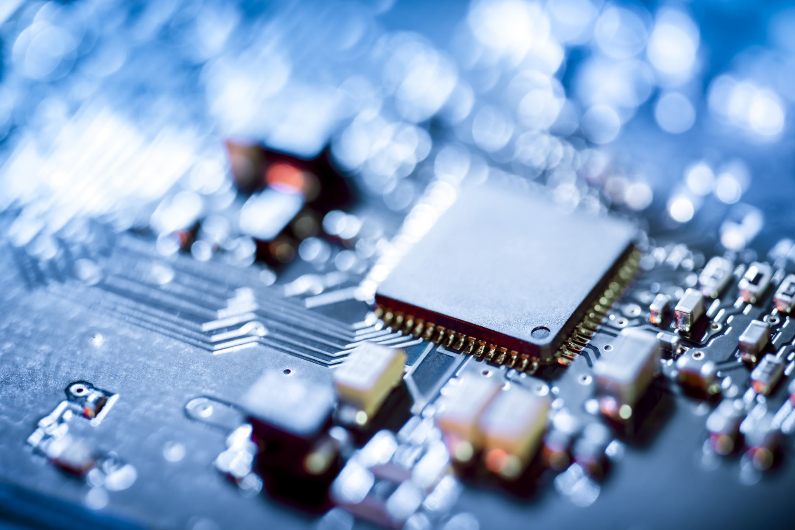
Introduction
Personal Introduction
Topic Introduction
My name is Carter Moody, and I’m sixteen years old and a Junior in the Scholars Academy. I plan to pursue an Engineering degree, and in my free time I enjoy playing with my dog.
My presentation is about computer hardware, and in it I explain what it is, why it’s important, and its future.

Slide 3



What is Computer Hardware?
Computer Hardware is any part of a computer system that you can physically touch.
Hardware can be both within the computer, such as the CPU or Motherboard, or it can be an external component such as a printer or monitor.
Both hardware and software are required for computer systems to work but this presentation focuses on hardware, or rather the brawn of the system whereas software is the brains.

Slide 4
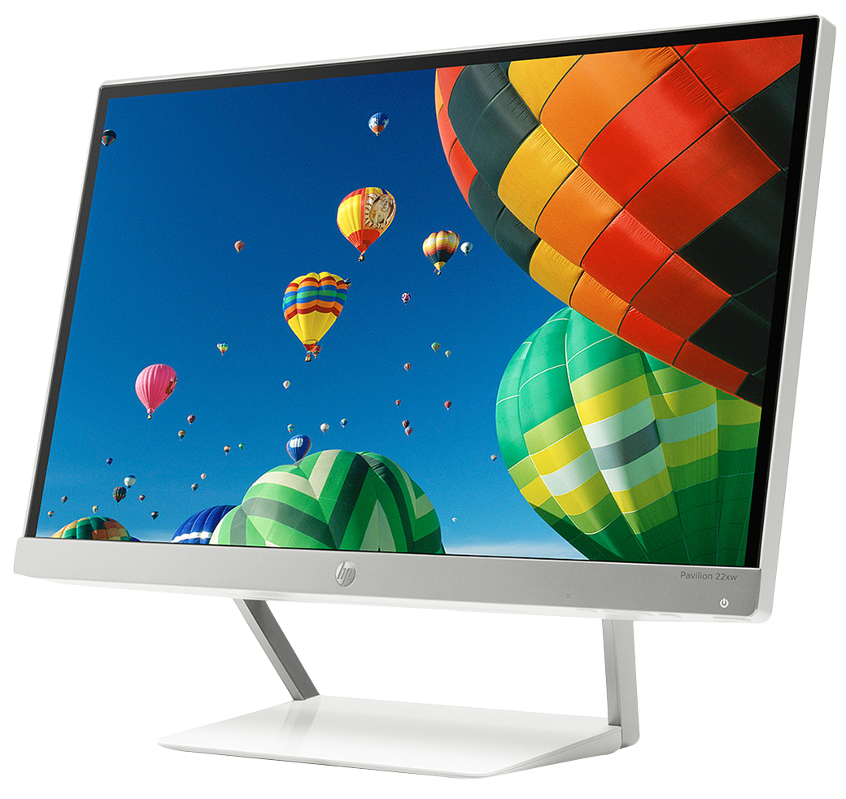
Why Do We Need Computer Hardware?
The hardware in a computer system provides the physical needs for the system to run. Without hardware, there’d be no way to power any components, process any data, or interact with/display software.

Slide 5

The Future of Computer Hardware
Moore’s Law of the doubling of our computing power every year may not have been exactly right, but this prediction has some validity to it. Current technologies will be improved upon to become more condensed and faster, and new devices such as quantum computers and nanotech will result in an unprecedented amount of computing power.
The future holds many uncertainties, but we can be sure of one thing, innovations in computer hardware will be at the center of our increasingly digital society.

